Slide 2
Risk factors & prevention of fall in older adult
Doaa Mosad
Lecturer of Rheumatology and Rehabilitation department
Mansoura University
2020

Slide 3
How big is the problem?
More than one-third of adults 65 and older fall each year in the United States.
Falls result in disability, functional decline, and reduced quality of life.
Falls are the leading cause of injury-related deaths: every hour an older adult
dies as a result of a fall.
Falls are the most common cause of traumatic brain injuries (TBI).

Slide 4
Risk factors of fall in geriatric
The cause of most falls is multifactorial, involving the interaction of risk factors.
There are four categories of risk factors: biological, behavioral, environmental, and socioeconomic.
Socioeconomic factors indirectly increase the risk for falling.
The risk of falling increases dramatically as the number of risk factors increases.

Slide 5
Risk factors of fall in geriatric
Biological Factors
1-Changes in Postural Control
Decreased proprioception
Slower righting reflexes
Decreased muscle strength and range of motion, especially of the lower extremity
Increased postural sway
Orthostatic hypotension
2-Changes in Gait
Lower foot swing height
Slower gait
Increased variability

Slide 6
3-Declining Visual Abilities
Contrast sensitivity
Declining visual fields
Visuospatial function
Increased sensitivity to glare
4-Chronic Illnesses
Parkinson’s disease
Stroke
Arthritis
Dementia

Slide 7
Other medical Conditions that Predispose Older Adults to Falls
Anemia
Arrhythmias
carotid sinus hypersensitivity
Dehydration
Infections (e.g., pneumonia, sepsis)
Metabolic disorders (e.g., thyroid disorders, hypoglycaemia)
Postural hypotension
Valvular heart disorders
Acute labyrinthitis
Benign paroxysmal positional vertigo
Hearing loss
Meniere’s disease

Slide 8
Behavioral Factors
Polypharmacy/use of certain medications
Excess alcohol use
Physical inactivity
Inappropriate or worn footwear
Main medications include:
Benzodiazepines
Antidepressants
Antipsychotics
Antiepileptic
Antihypertensive as ACE inhibitors
Antiarrhythmic
Cardiac glycosides

Slide 9
Environmental Factors
Poor lighting
irregular floor surfaces
Cluttered environments
Furniture that is too low or too high
Unsafe stairways
Bathroom fixtures that are too low or too high or that do not have arm support
Incorrect size, type, or use of assistive devices
Poorly designed public spaces

Slide 10
\

Slide 11
Assessment of fall risk factors
History
Medication
Vision
Gait and balance
Lower limb joints
Neurological
Cardiovascular

Slide 12
Assessment of fall risk factors

Slide 13
Fall Prevention Program
Main components of a successful fall prevention program
• Education about falls and fall risk factors
• Exercises that improve mobility, strength, and balance that are taught by trained personnel
• Medication review conducted by pharmacist or health-care providers to identify side effects or interactions that may contribute to falls
• Vision exams by optometrist or ophthalmologist
• Home safety assessment and home modification by occupational therapists or trained personnel
Changes in environment and activity to reduce the likelihood of recurrent falls

Slide 14
Management of Fall Risk for Older Persons
Treatment of underlying medical causes, if possible
1-Modification of salt restriction; adequate hydration, compensatory strategies (e.g., elevation of head of bed, rising slowly; pressure stockings)
2-Pharmacologic therapy if the above strategies fail
3-Ample lighting without glare; avoidance of multifocal glasses while walking; referral to an ophthalmologist
reduction of medications that impair balance& cognition
Environmental interventions: Removal of loose rugs and use of nightlights, nonslip bathmats, and stair rails
Appropriate footwear that encases the foot and has a low heel and thin sole
Referral to physical therapist for assistive devices, gait and progressive balance training

Slide 15
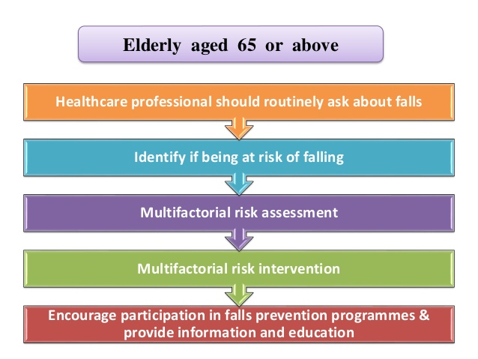
On conclusion

